Slide 1

Object Oriented Software Engineering
UML
Lecture 3

Slide 2
Today’s Outline:
Introduction to Use-Case

Slide 3
UML Use Case Diagram
A use case diagram is used to represent the dynamic behavior of a system. It encapsulates the system's functionality by incorporating use cases, actors, and their relationships.

Slide 4
Purpose of Use Case Diagrams
The main purpose of a use case diagram is to portray the dynamic aspect of a system. It accumulates the system's requirement, which includes both internal as well as external influences. It invokes persons, use cases, and several things that invoke the actors and elements accountable for specifications.
Following are the purposes of an use case diagram given below:
It gathers the system's needs.
It depicts the external view of the system.
It recognizes the internal as well as external factors that influence the system.
It represents the interaction between the actors.

Slide 5
INTRODUCTION
The most important phase in the software development life cycle is the requirements gathering stage. If the requirements are gathered collected correctly and unambiguously, the developed system will have high chances of being accepted. The use case diagrams help in gathering the requirements.

Slide 6
NEED FOR USE CASES
When we are dealing with project development, there is a need to capture the requirements correct, unambiguously. The requirement gathering phase in the software development phase allows us to collect requirements. The requirement collection defines the functionality to be provided and identifies the goals to be achieved. The requirements must be precisely and completely understood by the team providing the solution. User requirements keep changing, so the requirements must be well-documented. A thorough and unambiguous understanding of the requirements is vital to ensure that everyone knows what they are doing and why. The requirements must be reviewed again and again before the design and implementation begins. This phase involves the participation of the domain experts to ensure that the requirements have been correctly understood. This phase captures the ‘WHAT’ of the problem.

Slide 7
DIAGRAM MODEL ELEMENTS
There are three elements used in the use case model.
• Actors
• Use cases
• Relationships
The relationships are of three types
• Between actors and use cases
• Between use cases
• Between actors

Slide 8
Use case diagram components
Actors: The users that interact with a system. An actor can be a person, an organization, or an outside system that interacts with your application or system. They must be external objects that produce or consume data.
System: A specific sequence of actions and interactions between actors and the system. A system may also be referred to as a scenario.
Goals: The end result of most use cases. A successful diagram should describe the activities and variants used to reach the goal.

Slide 9
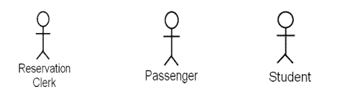
Actors
An actor represents a role that interacts with the system. It represents a role, not an individual. A person, a device or another system can be an actor. The communication of the actor with the system is established through sending and/or receiving messages. An actor may participate in many use cases and a use case may have several actors participating in it. The notation used for a use case is a stick person or a node or a device symbols and the role name is written below it. To simplify the matter one can simply use a role written inside << >> to specify the actor name.

Slide 10
Finding actors
There are certain points on the basis of which one can think of searching for the actors in the system.
• Who uses the main functionality of the system?
Reservation clerk, Passenger, Customer, Manager
• Which hardware devices the system needs to handle?
Printer, Scanner, RFID reader, Barcode reader
• Which other systems does the system need to interact with?
Paypal, Bank, Salary calculator, Tax calculator
• What nouns are used to describe the system?
User, Reservation clerk, Administrator

Slide 11
Use cases
This is an abstraction of a set of sequences that yield some functionality. E.g. login, book a ticket, purchase item. Login can be correct login or incorrect login where user may have provided the username, password or both incorrectly. So under the use case login both these scenarios will be captured. There is no need to specify two separate use cases login correctly and login incorrectly. As also the three possibilities for incorrect login also will be covered. Use case represents some user-visible function. Login is a user visible function. It will not describe how actually the login will be done, what steps are involved in it. Use case is always initiated by an actor. It describes the interaction between the actors and the system to get some function performed. This achieves some discrete goal for the actor. Use cases are narrative descriptions of business processes. A use case represents from start to finish, a sequence of events, actions and transactions required to produce or complete something of value to an actor. The notation used for a use case is an oval with the use case written inside it. Since use cases are ‘WHAT’ of the system, the actions performed they are written as verbs or verb phrases. So ticket will not be a use case whereas print ticket, book ticket, get ticket will be use cases.

Slide 12

Use cases

Slide 13
Finding use cases
The following points can be considered when looking for the use cases in the system.
• What functions the system is expected to perform?
Update the database periodically. The system is remotely shut down at 8pm and booted at 6am every day.
• What do the actors expect system to perform?
Display the train list. Show the fares for different classes of accommodation.
• What are the inputs and outputs expected by the system?
The system will print the ticket. The customer gets the reservation form. A sales report is generated at the end of the day. A list for items which have reached reorder level is generated and sent to the manager.
• What are the verbs which are used to describe the system?
The reservation clerk makes the booking using the system. The railway administrator can add new trains, modify existing train details. A customer can fill in the reservation form.

Slide 14

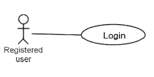
Relationships
Any use case has to be initiated by an actor. All the use cases are not initiated by all the actors. Any actor initiates some of the use cases. To indicate which actor initiates which use case there has to be a relationship between them. This link indicates interaction between a specific actor and a specific use case. The notation used for this relationship between actor and use case is a plain line between the relevant actor and use case.

Slide 15
Between use cases
There are two types of relationships that can exist between a pair of use cases. These are :
Include
Extend

Slide 16
Use/Include
When some behavior is similar across more than one use case, the common behavior is factored out and represented in a separate use case. The use cases that include the common behavior are related to the use case that represents the common behavior by the uses or includes relationship. Use case A uses or includes use case B when use case B is a behavior/functionality that is required by use case A. That behavior is factored out into a separate use case because it is required across several use cases. The notation used for the extend relationship is a dashed arrow with <> or <> written over it. The arrow head is toward the use case representing the common functionality. To decide the direction of the arrowhead a question should be asked “what gets included?” and put the arrow head along that use case.

Slide 17
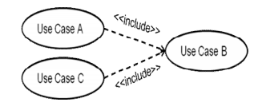
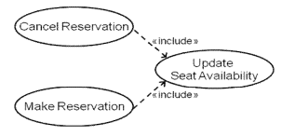
Example of include

Slide 18
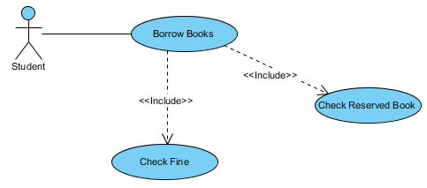
Example of include
The include relationship adds additional functionality not specified in the base use case. The <<Include>> relationship is used to include common behavior from an included use case into a base use case in order to support the reuse of common behavior.

Slide 19
Extend
This relationship is used to relate use cases which describe variations in the normal flow of events for a particular function to the basic use case which describes the normal flow of events for the function. An extending use case is used to describe variations in the normal flow of events described by a general use case. Use case B extends use case A when use case B describes the behavior of use case A under a particular condition. The notation used for the extend relationship is a dashed arrow with <> written over it. The arrow head is toward the use case representing the normal flow. To decide the direction of the arrowhead a question should be asked “what gets extended?” and put the arrow head along that use case.

Slide 20
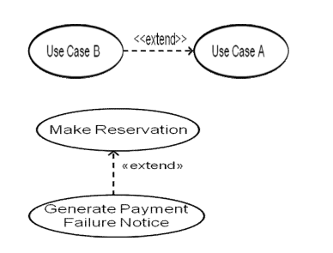
Extend

Slide 21

Use Case Example - Extend Relationship
The extend relationships are important because they show optional functionality or system behavior. The <<extend>> relationship is used to include optional behavior from an extending use case in an extended use case. Take a look at the use case diagram example below. It shows an extend connector and an extension point "Search".

Slide 22
Between actors
Two actors can be related only through the generalization-specialization relationship. This is used if the specialized actor is doing some kind of interaction which is not done by the rest of the actors who are involved in this relationship. If there are no additional special functionalities to an actor it is recommended not to use this relationship just for the sake of using it. The notation used a line with arrow head where the arrow head is empty triangular head. The head points toward the generalized actor.

Slide 23
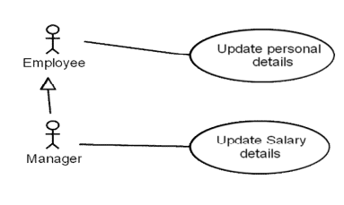
Between actors

Slide 24
USE CASE DIAGRAMS
The use case diagram is a graphical representation of the use cases of a system, its actors and the interactions between them. It also depicts the system boundary – what is included in the system, what is not included in the system, what is outside the system and interacts with the system. It is constructed from the use cases, actors and the relationships between them. A system boundary is optionally shown by drawing a rectangular box. The use cases are placed inside the box and the actors are placed outside the box. The interaction between the actor and use case is shown by a line intersecting the side of the box.

Slide 25
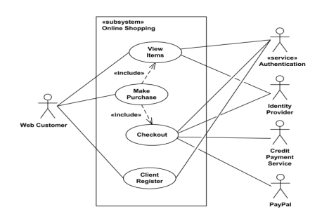
USE CASE DIAGRAMS

Slide 26
Generalization
Two actors can be related only through the generalization-specialization relationship. This is used if the specialized actor is doing some kind of interaction which is not done by the rest of the actors who are involved in this relationship. If there are no additional special functionalities to an actor it is recommended not to use this relationship just for the sake of using it. The notation used a line with arrow head where the arrow head is empty triangular head. The head points toward the generalized actor.

Slide 27
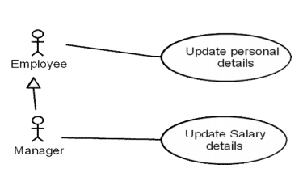
Generalization

Slide 28
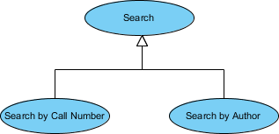
Use Case Example - Generalization Relationship
A generalization relationship means that a child use case inherits the behavior and meaning of the parent use case. The child may add or override the behavior of the parent. The figure below provides a use case example by showing two generalization connectors that connect between the three use cases.

Slide 29
Use Case Diagram - Vehicle Sales Systems
The figure below shows a use case diagram example for a vehicle system. As you can see even a system as big as a vehicle sales system contains not more than 10 use cases! That's the beauty of use case modeling.
The use case model also shows the use of extend and include. Besides, there are associations that connect between actors and use cases.

Slide 30
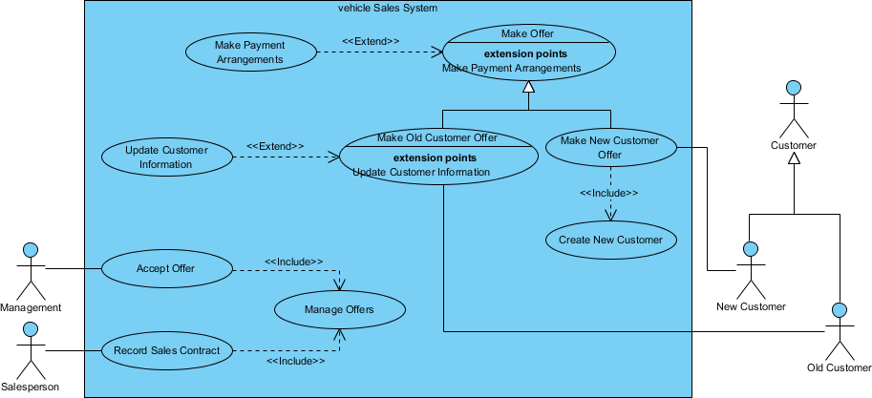
Use Case Diagram - Vehicle Sales Systems

Slide 31


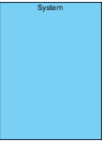



Use case Notations
Sr. No. | Icon | Name
1 |  | Use case
2 | _________ | Association
3 |  | Actor
4 |  | System
5 |  | Include
6 |  | Extend
7 |  | Dependency

Slide 32



Use case Notations
Sr. No. | Icon | Name
8 |  | Generalization
9 |  | Realization
10 |  | Collaboration

Slide 33
Activity
Use-case Diagram of
College Information System/Library Management system/ Hospital Management System/ Online shopping system/Banking System

Slide 34
Practical File
S. No. | Experiment Detail
1 | Introduction to UML and modeling software
2 | Introduction to Use-case Diagram
3 | Use-case Diagram of College Information System/Library Management system/ Hospital Management System/ Online shopping system/Banking System

Slide 35
Thank You

